Slide 1

Capstone Project
Face Emotion Detection System
Presented By
Chinmaya Devprasad
Hrushikesh Sahoo

Slide 2
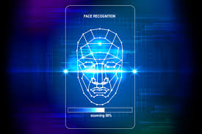
Content
The Problem Statement
Data Preparation and Understand the Data
Selection of Model
Train the Model
Test the model
Deployment of model
Challenges

Slide 3
Problem Statements
Face detection has been around for ages. Taking a step forward, human emotion displayed by face and felt by brain, captured in either video, electric signal (EEG) or image form can be approximated. Human emotion detection is the need of the hour so that modern artificial intelligent systems can emulate and gauge reactions from face. This can be helpful to make informed decisions be it regarding identification of intent, promotion of offers or security related threats. Recognizing emotions from images or video is a trivial task for human eye, but proves to be very challenging for machines and requires many image processing techniques for feature extraction. Several machine learning algorithms are suitable for this job. Any detection or recognition by machine learning requires training algorithm and then testing them on a suitable dataset.

Slide 4
Data Preparation
Data set name-- Kaggle fer-2013
Link:- https://www.kaggle.com/c/challenges-in-representation-learning-facial-expression-recognition-challenge/data.
Shape--
35,775 images belonging to 7 classes

Slide 5
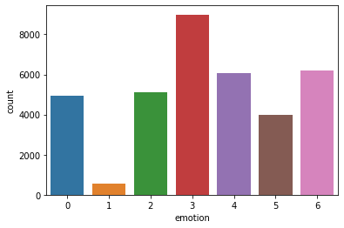
Understand the Data
0:anger
1:disgust
2:fear
3:happiness
4:sadness
5:surprise
6:neutral

Slide 6
Model Selection
Model Name | Epoch | Train Accu. | Test Accu.
MLP | 48 | 0.36 | 0.24
CNN | 48 | 0.56 | 0.46
RESNET | 48 | 0.32 | 0.25

Slide 7
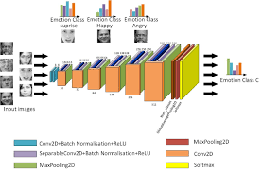
The Model
Total params: 4,478,727
Trainable params: 4,474,759
Non-trainable params: 3,968

Slide 8
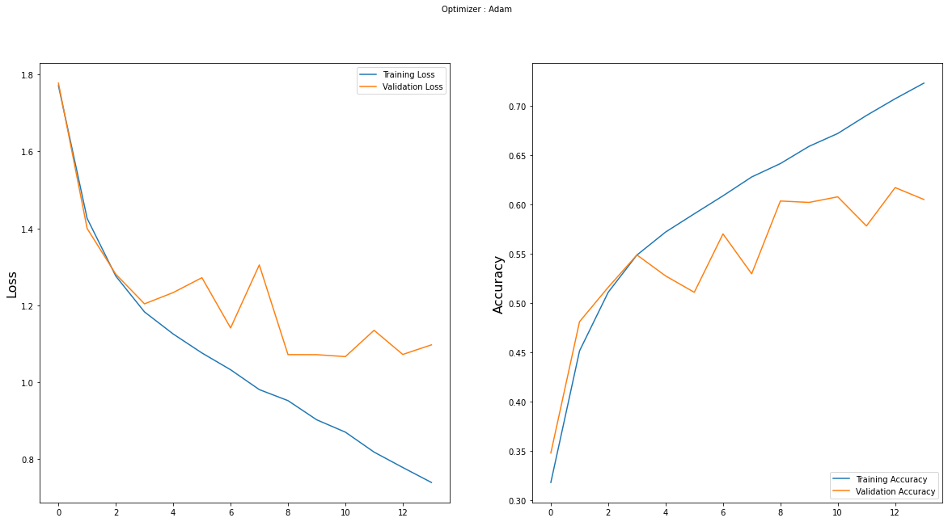
The Model

Slide 9
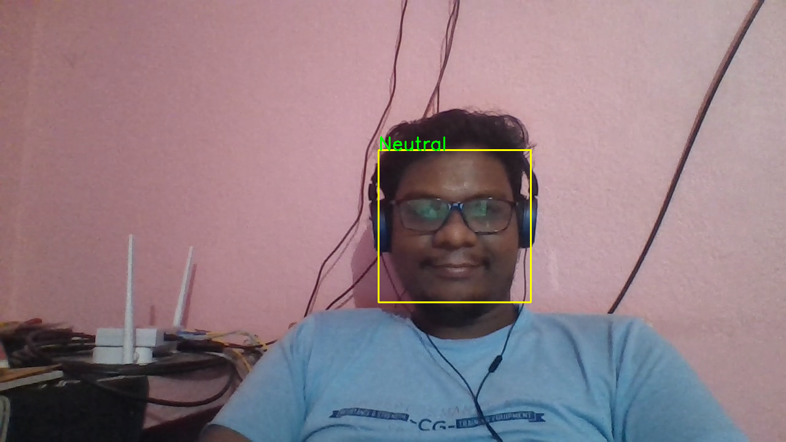
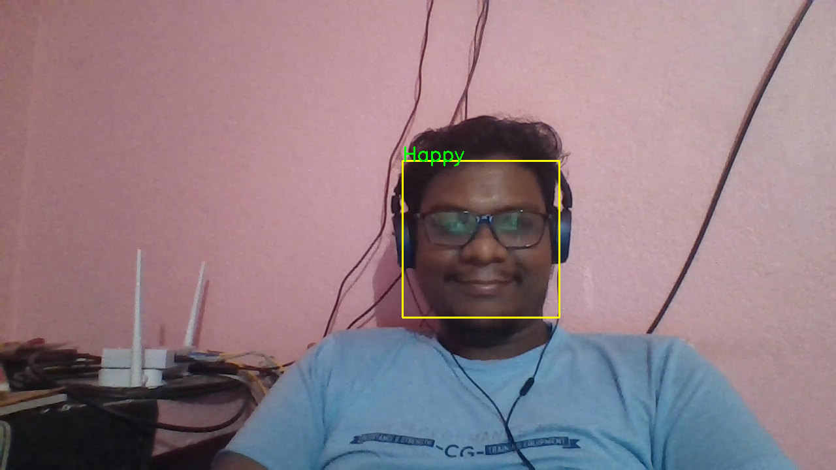
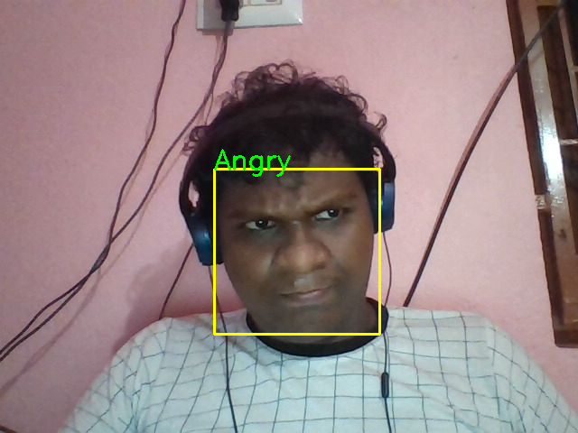
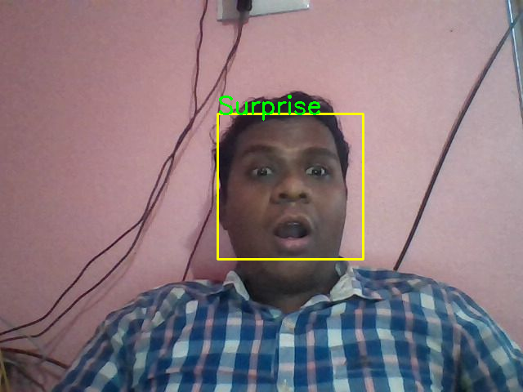
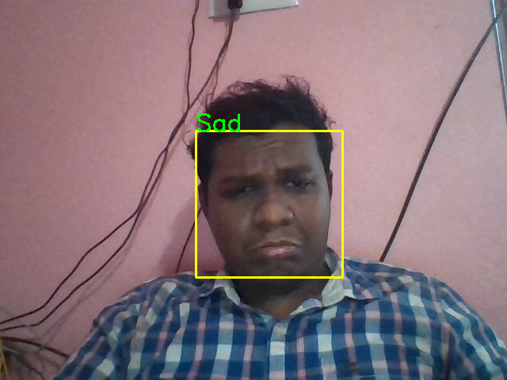
Test the model

Slide 10





The Deployment
With AMAZON(AWS) EC2
AWS Sage-maker(AWS) s3 Bucket
Heroku
AZURE

Slide 11
The Challenges
The Version Constraint
Space Constraint
Deployment Constraint
System Constraint
Time Constraint

Slide 12
Acknowledgement
I would like to express my special thanks of gratitude to our Mentor Ms. Eesha Goel helped us in doing a lot of Research and i came to know about so many new things I am really thankful to her . Secondly i would also like to thank our aravali members who helped me a lot in finalizing this project within the limited time frame.

Slide 13

Thank You

